Slide 1

Exploratory Data Analysis
Yellow Vs Pink Cab
06/21/22

Slide 2
Agenda
Problem Statement
Approach
EDA
EDA Summary
Recommendations

Slide 3
Problem Statement
XYZ is a private firm, and are planning to take up market share in the Cab Industry, and are wondering which company(ies) to invest in
There are two companies: Yellow Cab and Pink Cab
After receiving data on these two companies, they must pick one or the other to invest in

Slide 4
Approach
Understand the Data
Analysis of Profits: At the end of the day, profits propel business
Analysis of Demographics and Situations: depending on the location and values of firm XYZ, either cab company might be better than the other
Using these two analytics and our understanding of the data, make recommendations on investment strategies

Slide 5
EDA Approach #1: Understanding the Data
4 different files about each cab ride taken, customer information, transaction information, and information about cities merged into one final dataset with 16 features (2 derived).
After cleaning the data, 355,932 data points were analyzed
Certain Assumptions were made:
Trip duration is not known, so even though there are some outliers in the Price Changed column, I decided to keep those outliers.
The profit column I calculated was simply subtracting the Price Charged columns and the Cost of Trip columns, everything else was kept at 0.

Slide 6
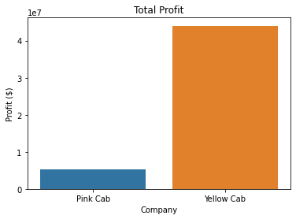
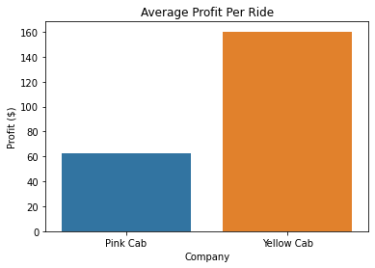
EDA Approach #2: Profit Analysis
Yellow Cab makes much more total profit and profit per ride than pink cab

Slide 7
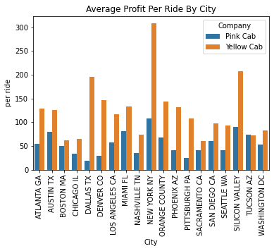
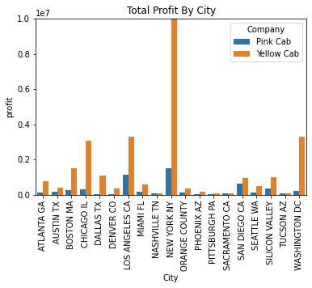
EDA Approach #2: Profit Analysis
But what if the XYZ firm is largely based in a city, and cares mostly about the positive effects in this city?
Again, Yellow Cab wins as far as total profit and average profit per ride in every city

Slide 8
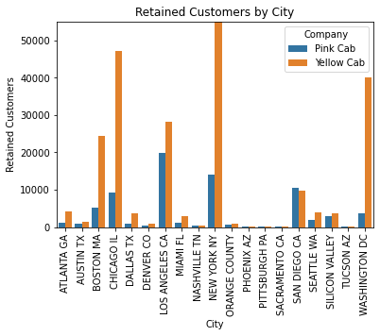
EDA Approach #3: Analysis of Demographics and Situations
Which company retains more users (defined as 3+ rides)
Yellow Cab has much better customer retention in every city

Slide 9
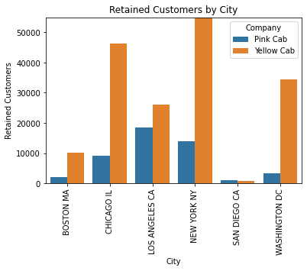
EDA Approach #3: Analysis of Demographics and Situations
But what if we redefined what it means to be “retained”? What if now its defined as 15+ rides? Does Pink Cab have the loyalist customers
While Pink Cab in San Diego has more retained users than Yellow Cab, the differences in every other city heavily outweigh this victory, once again favoring Yellow Cab

Slide 10
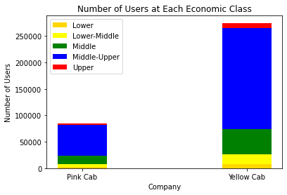
EDA Approach #3: Analysis of Demographics and Situations
Lots of times, its better for profitable companies to have affluent users, as they are in a better financial situation to spend money on the product.
Here we see that Yellow Cab has many more of each category than Pink Cab, but this doesn’t tell the whole story
In order to tell the full story, let’s compare percentages.

Slide 11
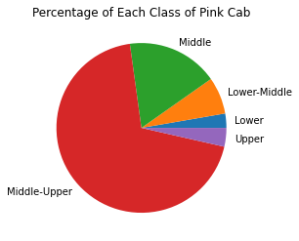
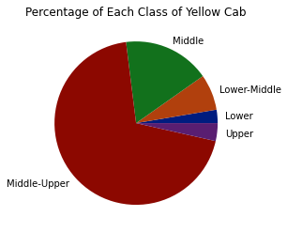
EDA Approach #3: Analysis of Demographics and Situations
The percentage by economic class is shown, and they are nearly identical

Slide 12
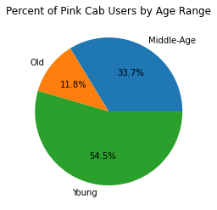
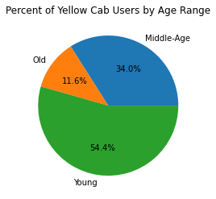
EDA Approach #3: Analysis of Demographics and Situations
Comparing the ages of their users, we see that they have similar percentages, but similar to economic class, yellow cab still has more users

Slide 13
EDA Summary
Total Profit and Profit per Ride favors Yellow Cab, no matter the city
Yellow Cab is much better at retaining customers, and it doesn’t matter how we define “retaining”
While Yellow Cab has much more users at each category, both Pink and Yellow Cab have similar percentages of users at each economic class level
Age Range follows the same structure as economic class, described above

Slide 14
Recommendations
Profits: Yellow Cab leads in both total profit and avergage profit per ride as opposed to Pink Cab
Retention: Yellow Cab leads Pink Cab as far as customer retention, no matter how we define how many rides counts as retention
Economic Class: While percentages are equal, Yellow Cab has many more affluent users than Pink Cab, which normally leads to the continuation of profits
Age Range: While percentages are equal, Yellow Cab has a strong presence in each age range, while Pink Cab does not
Because of these 4 points, we recommend investing in Yellow Cab

Slide 15
Thank You

